Slide 1
CPOS
Advisor Training
2/3/23

Slide 2
Agenda
Announcements
Karlisha Benymon – ROTC Advisor
Cody
Pre-Health/Pre-Law Advising
Look before you Leap
CPOS
Plans for non-registered students
Questions

Slide 3
Annoucements
Summer 23 scheduled has rolled
Schedulers can make changes from Monday Feb 6th – Tuesday, March 14th at 4:30 pm
NEW Late Withdrawal Deadline
75% mark – April 8, 2023
Intent to Graduate
Please remind your students to Apply to Graduate
Deadlines Summer, April 5th and Fall, July 5th
Upgrades for Navigate Academic Planning Tool
I will reach out to departments for plan accuracy

Slide 4
Announcements cont.
Incomplete Grade
deadline moved to the end of the semester. Any Spring student who receives an Incomplete for Spring grades will have until the end of the Fall semester to complete the work. At the end of the Fall semester, the grade will change to an F.
Fall Incompletes – per provost, are due at the end of the Spring 23 semester
Instructor Role in Late Withdrawal Process – need instructor input.
Pre-Health/Pre-Law Advising – Cody
Look before you Leap - Cody

Slide 5
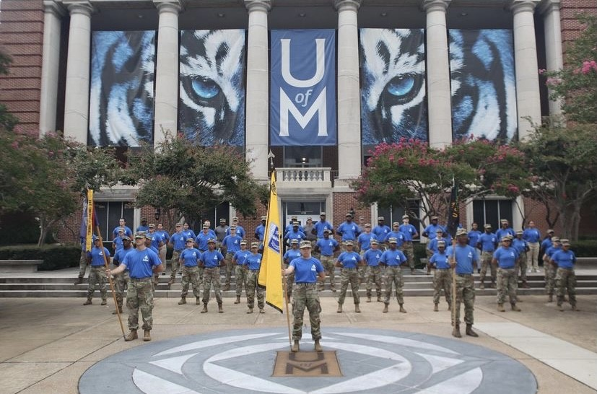
Karlisha Benymon
Army ROTC
Recruiting and Operations Manager
Earning A Minor in Military Science

Slide 6
Most Cadets can earn a Minor in Military Science. There are several prerequisites:
Contracted
No grade lower than C
Must be either progressive, lateral entry or NG/USAR
Take the 18 hours of upper-level course work

Slide 7
18 semester hours consisting of:
ARMY 3200 - Warfighting Functions/Training Credit Hours: (2)
ARMY 3201 - Warfighting Functions/Training Lab Credit Hours: (1)
ARMY 3205 - History of Military Tactics Credit Hours: (2)
ARMY 3300 - Small Unit Leadership Credit Hours: (2)
ARMY 3301 - Small Unit Leadership Lab Credit Hours: (1)
ARMY 4200 - The Army Officer Credit Hours: (2)
ARMY 4201 - The Army Officer Lab Credit Hours: (1)
ARMY 4300 - Company Grade Leadership Credit Hours: (2)
ARMY 4301 - Company Grade Leadership Lab Credit Hours: (1)
ARMY 1000 - *4 Physical Training courses Credit hours (4)
* In the process of changing course number.

Slide 8
Other opportunities for Army ROTC students:
Signing Bonus
Scholarships
Stipends
Students can contact:
Ms. Benymon at
(901) 230-9627
kbenymon@memphis.edu

Slide 9
CPOS
Course Program of Study

Slide 10
6:30 am Email

Slide 11
These are the courses that currently do not fall into the student’s major or minor on UMDegree
Cody does all students majoring in a natural science
Rika does all other majors

Slide 12
Exceptions
Pre-reqs for required courses in the major, MATH 1720, COMP 1800
Pre-reqs for graduate school
Upper division hours.
Elective to get to 120 hours

Slide 13
UMDegree
This is why I need a note from the advisor.
I will email the advisor and the student.
Many of you are good a putting in the list of advised courses.
Sometimes a student wants to pick up a minor.

Slide 14
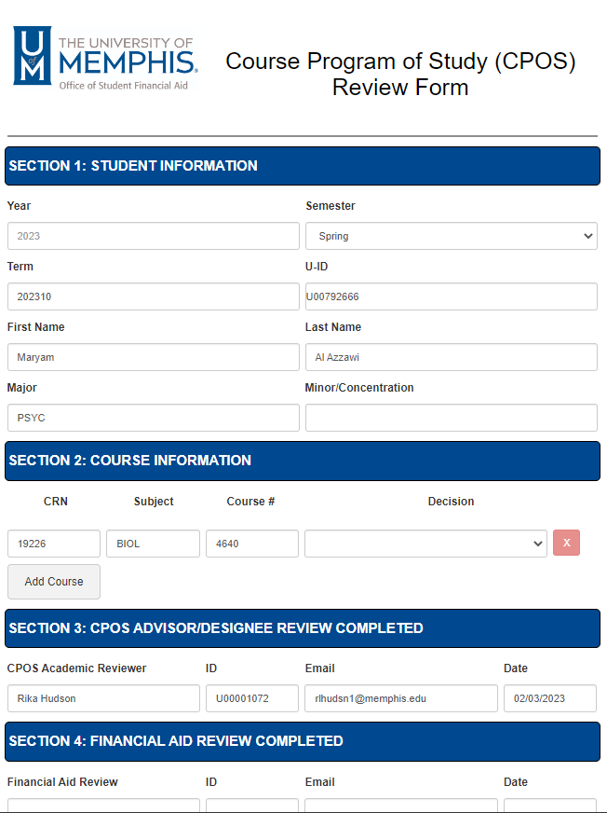
Sample CPOS FORM
Decision
Satisfies Degree requirement
Satisfies Pre-req for required course
Required preparatory work for Grad School
Does not satisfy degree requirement for major or minor
Does not satisfy degree requirement: Elective hours exceeded

Slide 15
CPOS notes

Slide 16
Plans for non-registered students
Problem: Mass clearing is going to happen
How do we get ahead of it?
Possible solution: After peak advising season ends, please enter generic plans for students who have not responded to outreach. I suggest using the catalog language

Slide 17
Questions???

