Slide 1
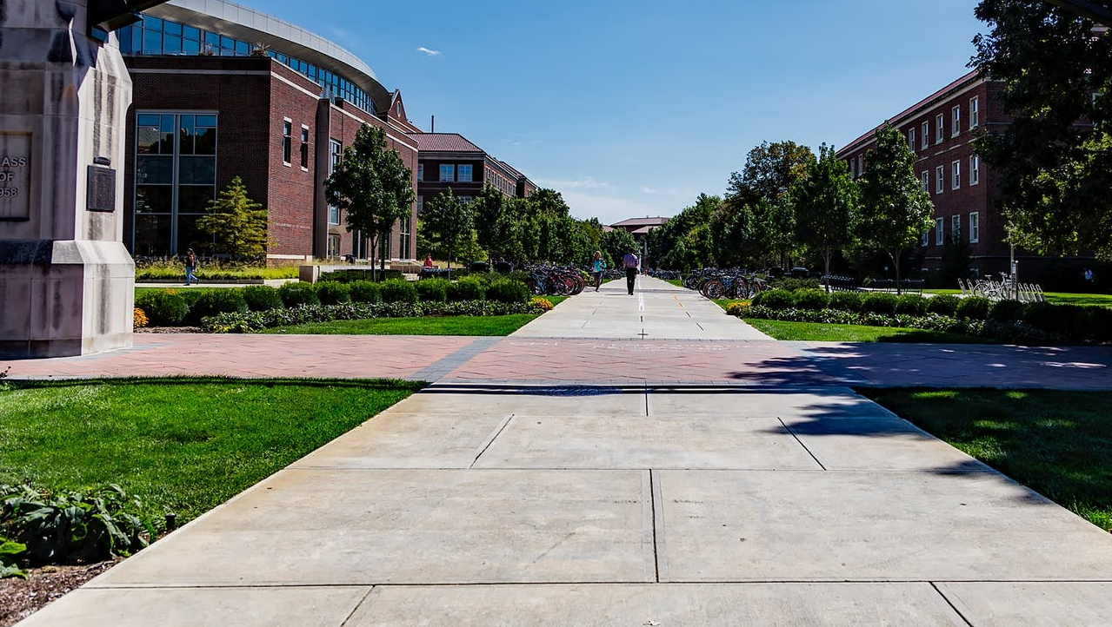
Tigers SmartStart
An innovative course material model supporting student outcomes
through equitable access, convenience, and affordability

Slide 2
Students are forgoing getting their course materials and it’s negatively impacting their success
85 PERCENT
of students delay or avoid purchasing course materials and 50 PERCENT of them said that it has negatively impacted their grades *
7 IN 10 students say they would have better grades if they had access to required textbooks and course materials before the first day of class
NACS Student Watch 2019-2020
“
Cost sometimes gets in the way of me purchasing a textbook. For some textbooks that are multiple hundred of dollars, I thought I could just wing it.
Jonathan D'Ercole, Student
Campbell University
”
*Vital Source Wakefield Study
Notes:
We are seeing that students just aren’t getting their course materials at an accelerated rate, and this is negatively impacting their success in the classroom.
Review one or two callouts from the slide

Slide 3
INTRODUCING FIRST DAY® COMPLETE
A proven solution that supports student success
by ensuring students have access to all their course materials on or before the first day of class
STUDENTS
AUTOMATICALLY
receive all their books and access to electronic materials on or before the first day of class
MATERIALS ARE INCLUDED
Applied as a per credit charge to the student account
SIGNIFICANT STRESS REDUCTION & COST SAVINGS
for students versus the traditional model
Notes:
First Day Complete helps to remove barriers for students.
Review slide and callout pillars
Access
Convenience
Affordability

Slide 4
SUPPORTS ENROLLMENT​
Increased Enrollment at Eastern Kentucky University
In Fall 2021, Eastern Kentucky University saw an enrollment increase of 8% among first-time freshmen – the only public four-year institution in Kentucky that saw a year-over-year increase.
The university considers First Day Complete an important resource for recruitment and retention.
25 PERCENT
Of freshman said that the course material program was a factor in their decision to attend their current school.*
* First Day Complete Spring 2022 Student Survey
Notes:
Eastern Kentucky University attributes the implementation of First Day Complete as an important resource for recruitment-
experiencing an increase of 8% among incoming freshman in Fall 2021

Slide 5
74 PERCENT
of students said the availability of the program increased their likeliness of continuing their education at the school**
SUPPORTS RETENTION​
IMPROVE COURSE COMPLETION RATES​
Research shows students who participate in First Day Complete are 15.58% more likely to complete the course then students that are not in an equitable access program.*
* Inclusive/Equitable Access Research Study, University of New Hampshire, July 2022
** First Day Complete Spring 2022 Student Survey
Notes:
* Reference: EA CCR: Moore, M. (2022). Equitable Access: A Participant v. Non-Participant Course Completion Rate Analysis from 2-Year Institutions. https://doi.org/10.35542/osf.io/drqz9.
Dr. Michael Moore, is a research scientist at the University of New Hampshire, studying the impact equitable access programs have on student outcomes.
Dr. Michael Moore’s Research:
Dissertation: Moore, M. (2022). Inclusive Access Course Materials: The Impact on Student Outcomes. https://doi.org/10.35542/osf.io/5s7ub
IA WCTC: Moore, M., & Piazza, B. (2022). Inclusive Access Course Materials: An Analysis of Waukesha County Technical College’s Inclusive Access Program. https://doi.org/10.35542/osf.io/nfu4g.
EA CCR: Moore, M. (2022). Equitable Access: A Participant v. Non-Participant Course Completion Rate Analysis from 2-Year Institutions. https://doi.org/10.35542/osf.io/drqz9.

Slide 6
FIRST DAY® COMPLETE CASE STUDY:
IMPROVING STUDENT OUTCOMES
An institution that implemented FDC in Fall Term 19 has seen a significant increase in Student Retention and Class Performance
Student Retention Improved Across All Ethnicities*
Students Are Achieving Better Results Across Disciplines**
+35%
+29%
BUSINESS
+18%
+22%
+16%
CHEMISTRY
+13%
ENGLISH
+5%
MATH
+8%
OVERALL
BLACK
ASIAN
HISPANIC
*Students that re-enrolled for a second consecutive semester and remained students through the end of that second semester. Tracked across Fall 2019-Spring 2020 and Spring 2020-Fall 2020 semesters.
**Percentage of students with a C grade or better. Tracked across Fall 2019-Spring 2020 and Spring 2020-Fall 2020 semesters
Notes:
Student outcomes – a study completed at a current First Day Complete partner – seeing improvement in both retention and academic success in the classroom.

Slide 7
https://invis.io/86115TRNUR7K
PERSONALIZED STUDENT EXPERIENCE
STEP 1 |
REGISTER FOR CLASS
VERIFY MATERIALS
STEP 2 |
STEP 3 |
SELECT FULFILLMENT METHODS
STEP 4 |
RECEIVE MATERIALS
END OF TERM:
RETURN MATERIALS
STEP 5 |
https://www.youtube.com/watch?app=desktop&v=OoI9TC7vrAo&feature=youtu.be
Notes:
Review slide

Slide 8
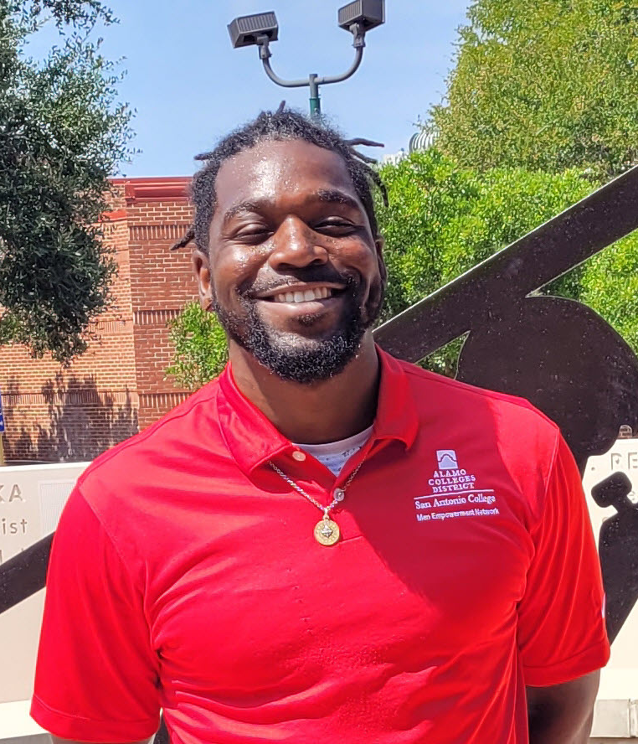
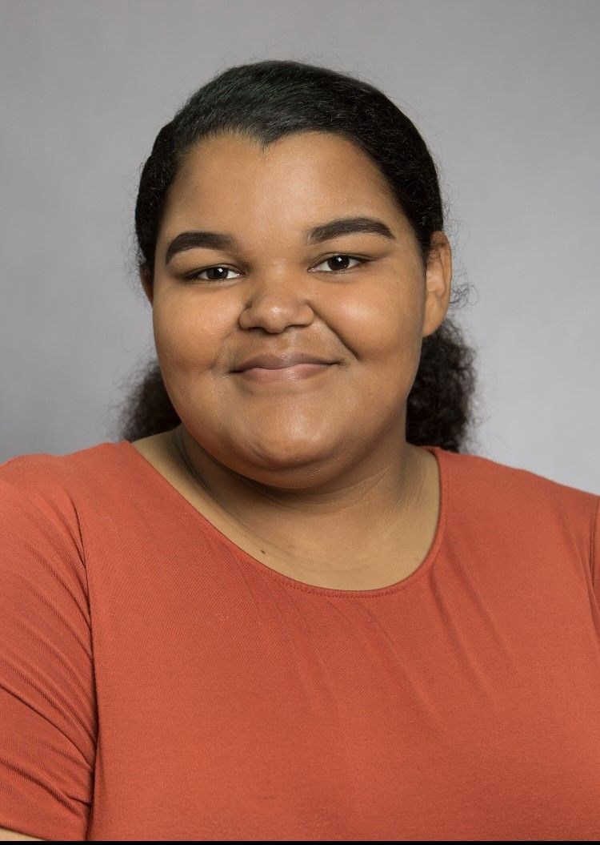
WHAT STUDENTS ARE SAYING…
“Not having to worry about books really takes a load off and is more convenient. Before this program, I didn’t have all my materials and my grades were affected.”
Jose Valesquez
Lees-McRae College
76 PERCENT
would want to participate in the program in the future
“
The program is going to help change a lot of people’s lives.
Molly McGowan
Eastern Kentucky University
”
“This program has given me the opportunity to be able to pick up my books on time and be ready for classes.”
Robert Jordan
Alamo Colleges District
66 PERCENT
reported the program had a positive impact on their academic success
63 PERCENT
said the availability of the program increased their likeliness of continuing their education at the school
“
70 PERCENT
said the program provided them more affordable course materials
“Before the program I decided not to buy the books for a class on some occasions. I definitely feel less stress now having the book at the beginning of the semester.”
Cassondra Hall
Jacksonville University
I just went online, logged in and registered, and the books are automatically synced to the classes that I was in.
Terrell Richardson
North Carolina A&T
”
Notes:
We listen to the students and faculty on your campus about the program for continued success
Review slide and highlight a few quotes

Slide 9
IMPROVING EQUITABLE ACCESS, CONVENIENCE & AFFORDABILITY AT
THE UNIVERSITY OF MEMPHIS
Full Time Student would now only spend
$360
(Based on 15 credit hours)
*U of M currently recommends allocating
$800
for books and supplies an
academic term
First Day Complete Pricing per credit hour
$24
*https://www.memphis.edu/financialaid/eligibility.php
Notes:
We have already reviewed equitable access and convenience and how that benefits student outcomes and with affordability – pricing is customized for your campus.

Slide 10
Student Timeline
Students will have their books shipped to them or pick them up at the bookstore once on campus
By Dec 5
30 days
Jan 27
Last day of finals
Return their Books
Selection Opens
Emails
Last Day to Opt Out
Materials should be returned by the last day of finals
Welcome Email and a Selection Email
Students can make choices beginning 30 days before classes (delivery method or opt out)
This is the 50% refund date and the last day to opt out of the program
Tigers SmartStart Landing Page

Slide 11
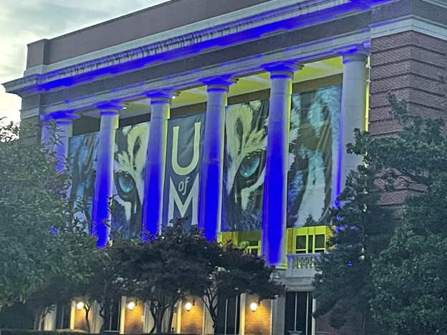
Amanda Lowe
General Manager
Certified Textbook Trainer
University of Memphis Bookstores
​Phone: (901) 678-2011 Ext 3976
Email: alowe@bncollege.com
Email: alowe5@memphis.edu
Website: memphis.bncollege.com
Tiger SmartStart FAQS

